Slide 1
Dense Vector Representations
Jurafsky, D. and Martin, J. H. (2018) Speech and Language Processing. An Introduction to Natural Language Processing, Computational Linguistics and Speech Recognition. Third Edition, Draft: Chapter 6
D. Blei. Introduction to probabilistic topic models. Communications of the ACM, 2012
Mark Steyvers; Tom Griffiths (2007) "Probabilistic Topic Models" In: T. Landauer, D McNamara, S. Dennis, and W. Kintsch (eds), Handbook of Latent Semantic Analysis, Psychology Press.
Tomas Mikolov, Kai Chen, Greg Corrado, and Jeffrey Dean. Efficient estimation of word representations in vector space. ICLR Workshop, 2013.
IR Book Chapter 18: https://nlp.stanford.edu/IR-book/pdf/irbookonlinereading.pdf
LSA, Generative Topic Models (LDA), Neural Word Embeddings (word2vec)
Slides credit: Martin Riedl, Alexander Panchenko
18/06/19
Language Technology Group – Chris Biemann

Slide 2
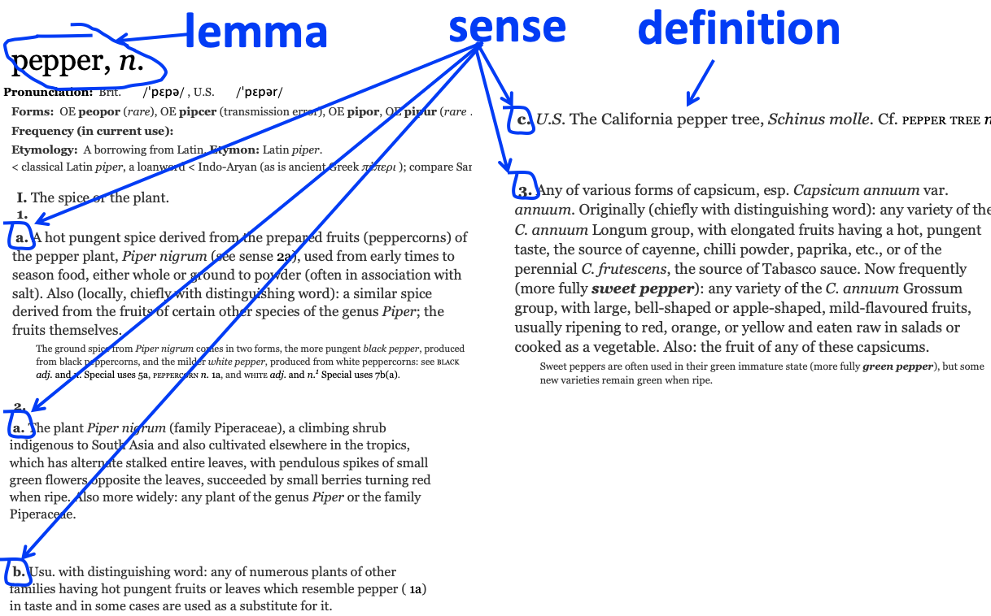
What do words mean?
First thought: look in a dictionary, e.g.: http://www.oed.com
18/06/19
Language Technology Group – Chris Biemann

Slide 3
Ask humans how similar two words are
word1 | word2 | similarity
vanish | disappear | 9.8
behave | obey | 7.3
belief | impression | 5.95
muscle | bone | 3.65
modest | flexible | 0.98
hole | agreement | 0.3
SimLex-999 dataset (Hill et al., 2015)
Felix Hill, Roi Reichart and Anna Korhonen (2015): SimLex-999: Evaluating Semantic Models with (Genuine) Similarity Estimation. Computational Linguistics 41(4):665-695
18/06/19
Language Technology Group – Chris Biemann

Slide 4
Classical (“Aristotelian”) Theory of Concepts
The meaning of a word: a concept defined by necessary and sufficient conditions
A necessary condition for being an X is a condition C that X must satisfy in order for it to be an X.
If not C, then not X
”Having four sides” is necessary to be a square.
A sufficient condition for being an X is condition such that if something satisfies condition C, then it must be an X.
If and only if C, then X
The following necessary conditions, jointly, are sufficient to be a square
x has (exactly) four sides
each of x's sides is straight
x is a closed figure
x lies in a plane
each of x's sides is equal in length to each of the others
each of x's interior angles is equal to the others (right angles)
the sides of x are joined at their ends
18/06/19
Language Technology Group – Chris Biemann

Slide 5
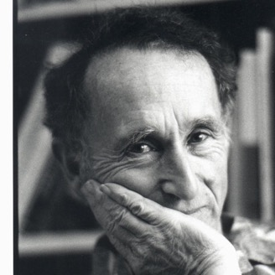
William Labov’s (1975) definition of cup
18/06/19
Language Technology Group – Chris Biemann

Slide 6
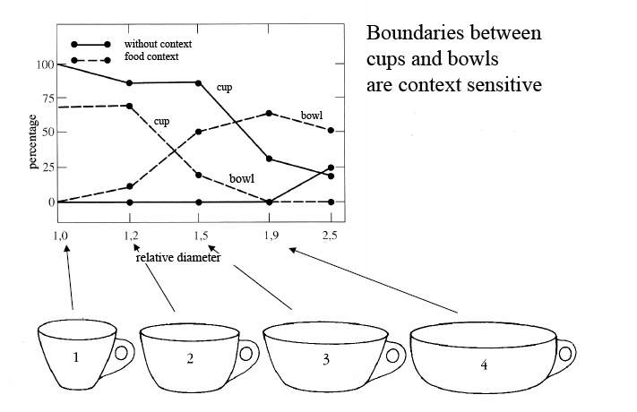
The category depends on the context! If there is food in it, it’s a bowl
18/06/19
Language Technology Group – Chris Biemann

Slide 7
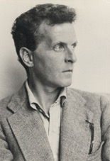
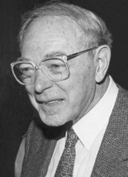
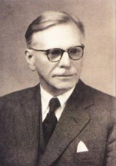
“data-driven approach” to derivation of word meaning
Ludwig Wittgenstein (1945): “The meaning of a word is its use in the language”
Zellig Harris (1954): “If A and B have almost identical environments we say that they are synonyms”
John Firth (1957): “You shall know the word by the company it keeps.”
18/06/19
Language Technology Group – Chris Biemann

Slide 8
What does “ong choi” mean?
18/06/19
Language Technology Group – Chris Biemann

Slide 9
What does “ong choi” mean?
Suppose you see these sentences:
Ong choi is delicious sautéed with garlic.
Ong choi is superb over rice
Ong choi leaves with salty sauces ..
18/06/19
Language Technology Group – Chris Biemann

Slide 10
What does “ong choi” mean?
Suppose you see these sentences:
Ong choi is delicious sautéed with garlic.
Ong choi is superb over rice
Ong choi leaves with salty sauces
And you've also seen these:
…spinach sautéed with garlic over rice
Chard stems and leaves are delicious
Collard greens and other salty leafy greens
18/06/19
Language Technology Group – Chris Biemann

Slide 11
What does “ong choi” mean?
Suppose you see these sentences:
Ong choi is delicious sautéed with garlic.
Ong choi is superb over rice
Ong choi leaves with salty sauces
And you've also seen these:
…spinach sautéed with garlic over rice
Chard stems and leaves are delicious
Collard greens and other salty leafy greens
Conclusion:
Ong choi is a leafy green like spinach, chard, or collard greens
18/06/19
Language Technology Group – Chris Biemann

Slide 12
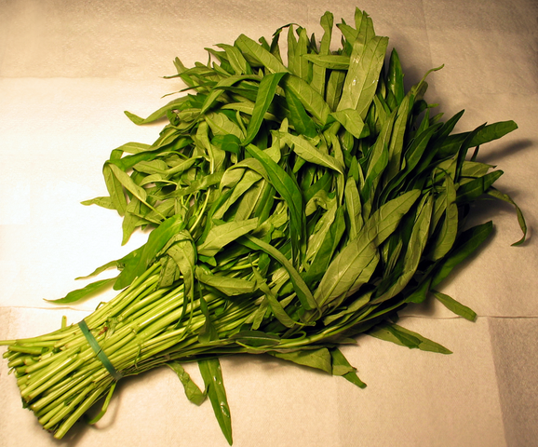
Ong choi: Ipomoea aquatica “Water Spinach”
Yamaguchi, Wikimedia Commons, public domain
18/06/19
Language Technology Group – Chris Biemann

Slide 13
Representation of Documents: The Vector Space Model (VSM)
(a.k.a. term-document matrix in Information Retrieval)
word vectors: characterizing word with the documents they occur in
document vectors: characterizing documents with their words
Documents
Words
 | d1 | d2 | … | di | … | dn
w1
w2
…
wj |  |  |  | n(di,wj)
…
wm
n(di, wj):= (number of words wj in document di) * term weighting
18/06/19
Language Technology Group – Chris Biemann

Slide 14
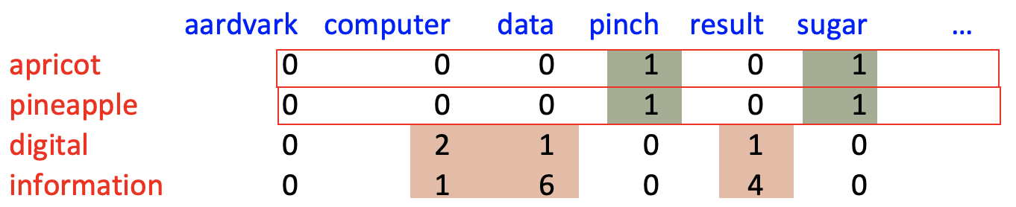
More common: word-word (term-context) matrix
Two words are similar in meaning if their context vectors are similar
18/06/19
Language Technology Group – Chris Biemann

Slide 15
More common: word-word (term-context) matrix
Do raw frequencies make sense here?
18/06/19
Language Technology Group – Chris Biemann

Slide 16
Reminders from linear algebra
vector length
18/06/19
Language Technology Group – Chris Biemann

Slide 17
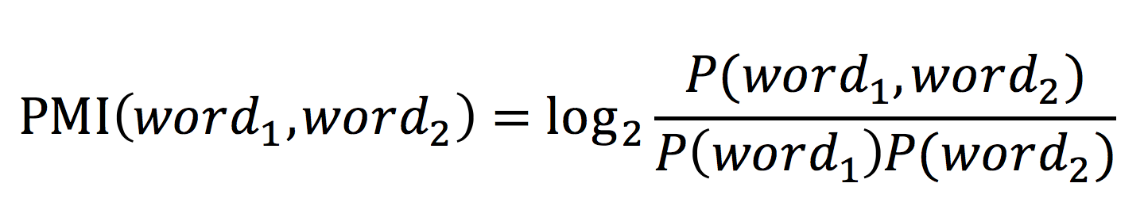
pointwise mutual information
Ask whether a context word is particularly informative about the target word.
Pointwise mutual information:
Do events x and y co-occur more than if they were independent?
PMI between two words:
Do words x and y co-occur more than if they were independent?
18/06/19
Language Technology Group – Chris Biemann

Slide 18
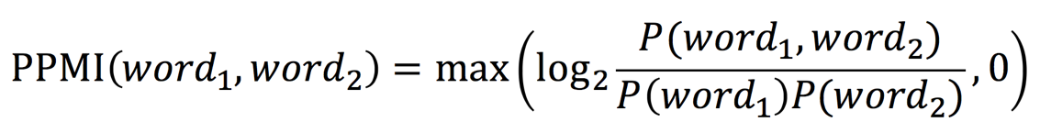
Positive Pointwise Mutual Information
PMI ranges from -∞ to +∞
But the negative values are problematic
Things are co-occurring less than we expect by chance
Unreliable without enormous corpora
Imagine w1 and w2 whose probability is each 10⁻⁶
Hard to be sure p(w1,w2) is significantly different than 10⁻¹²
“unrelatedness” is a strange notion, given the size of the vocabulary; how does tiger-window vs. wall-tree compare?
Positive PMI (PPMI) between word1 and word2:
18/06/19
Language Technology Group – Chris Biemann

Slide 19
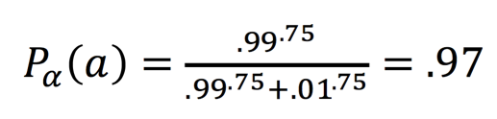
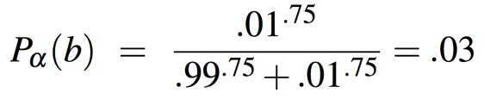
Weighting PMI: Giving rare words higher probability
Raise the context probabilities to e.g. α=0.75:
This helps because P_{α}(c) > P(c) for rare c
Consider two events, P(a) = .99 and P(b)=.01
18/06/19
Language Technology Group – Chris Biemann

Slide 20
Challenges in the plain VSM
PPMI and other plain vectors are long (length |V|= 20,000 to 50,000) and sparse (most elements are zero)
High dimensionality
large storage needed
slow processing
Sparse Matrix
Power Law Distribution of frequencies: many words occur only once
many zeros
Lack of Generalization
different words are distinct symbols, no matter how similar in meaning
e.g. synonyms are represented as different words, but should they be not mapped onto the same concept?
18/06/19
Language Technology Group – Chris Biemann

Slide 21
LSA – Latent Semantic Analysis What if the matrix was smaller?
Map Vector Space Model to a fixed lower number of dimensions
Mapping reflects semantic association
words with similar context should have a similar profile in the reduced dimension space
➔Map terms with similar meaning (in best case synonyms) to similar locations in a low dimensional space
➔Extract main dimensions of meaning and remove noisy dimensions
Scott Deerwester, Susan T. Dumais, George W. Furnas, Thomas K. Landauer, Richard Harshman (1990): Indexing by latent semantic analysis. Journal of the Association for Information Science and Technology 41(6):391-407
18/06/19
Language Technology Group – Chris Biemann
21

Slide 22
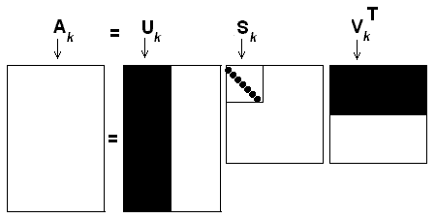
Singular Value Decomposition (SVD) The Method used by LSA
term-document matrix A can be decomposed by Singular Value Decomposition (SVD) into: A = U•S•V^{T} where
U: columns are the Eigenvectors of A•A^{T} (“left” EVs)
S: diagonal matrix of singular values: square roots of Eigenvalues
V: columns are the “right” Eigenvectors of A^{T}•A (“right” EVs)
can order the singular values in decreasing order. There are methods to iteratively compute singular values, starting from the largest.
approximating the original matrix by the k most important dimensions (topics) in the SVD representation:
A_{k} = U_{k}•S_{k}•V_{k}^{T} effectively, set all other values of s to 0.
Singular Values (Dimensions x Dimensions)
Document x Dimension
Documents x Terms
Dimensions x Words
Term by Dimension
18/06/19
Notes:
A is a sparse matrix.
Eigenvector: B·v=λ·v vectors that do not change under linear transformation of B=A*AT / B=ATA
λ is the corresponding Eigenvalue
there is SVD that decomposes it into left eigenvectors, singular values, right eigenvalues.

Slide 23
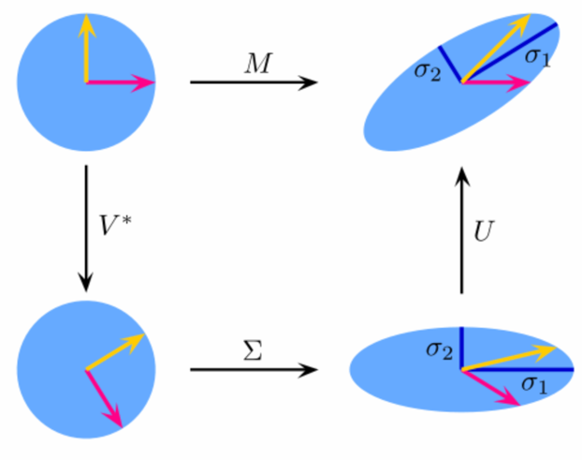
SVD Explained
A = U•S•V^{T}
U: rotate the axes into the direction of maximal variance
S: rescale the axes to achieve equal variance
V : rotate the input vectors according to the new axes
SVD is an orthogonal transform that de-correlates the variables.
Approximation to k dimensions keeps the ones with the largest variance.
Retain only U for word representations
A
V^{T}
U
S
https://technologiesrunning.blogspot.de/2016/12/10-algoritmos-de-aprendizaje-automatico.html
18/06/19
Language Technology Group – Chris Biemann

Slide 24
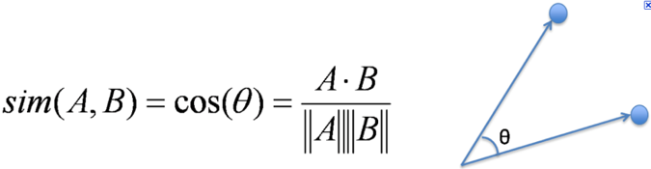
LSA in Practice
Compare words, compare documents
VSM: e.g. compute similarity between document vectors or word vectors using the cosine similarity
In LSA: compare reduced word vectors; project document vector into reduced document vector, then use cosine similarity
Building LSA matrices is typically done using a large background corpus with k=100~1000 dims (subject to hyperparameter tuning)
Why this works:
LSA can generalize over similar words
LSA serves as a noise reduction technique
LSA can fold in knowledge about lexical similarities beyond what is learnable from smaller labelled/annotated training data
18/06/19
Language Technology Group – Chris Biemann
24

Slide 25
Example CORPUS
words
b b b b m m m m m m l l l l l l
b b b b b m m m m m m m l l l l
b b b b b b b m m m m m l l l l
b b b b b b b m m m m m m l l l
b b b b b b b m m l l l l l l l
b b b b b b b b b m m m l l l l
r b b b b m m m m m m m l l l l
r s s b b b b b b m m m m l l l
r s s s b b b b b b m m m m l l
r r s s s b b b b b b m l l l l
r r s s s b b b b b b b m m m l
r r r s s s s s s b b b b b b m
r r r r r r s s s b b b b b b l
r r s s s s s s s s b b b b b b
r r r r s s s s s s s b b b b b
r r r r r s s s s s s s b b b b
With:
b: bank
m: money
l: loan
r: river
s: stream
documents
18/06/19
Language Technology Group – Chris Biemann

Slide 26
LSA Example
Perceive Corpus as VSM
ID | b | r | s | m | l
1 | 4 | 0 | 0 | 6 | 6
2 | 5 | 0 | 0 | 7 | 4
3 | 7 | 0 | 0 | 5 | 4
4 | 7 | 0 | 0 | 6 | 3
5 | 7 | 0 | 0 | 2 | 7
6 | 9 | 0 | 0 | 3 | 4
7 | 4 | 1 | 0 | 7 | 4
8 | 6 | 1 | 2 | 4 | 3
9 | 6 | 1 | 3 | 4 | 2
10 | 6 | 2 | 3 | 1 | 4
11 | 7 | 2 | 3 | 3 | 1
12 | 6 | 3 | 6 | 1 | 0
13 | 6 | 6 | 3 | 0 | 1
14 | 6 | 2 | 8 | 0 | 0
15 | 5 | 4 | 7 | 0 | 0
16 | 4 | 5 | 7 | 0 | 0
With:
b: bank
m: money
l: loan
r: river
s: stream
18/06/19
Language Technology Group – Chris Biemann

Slide 27
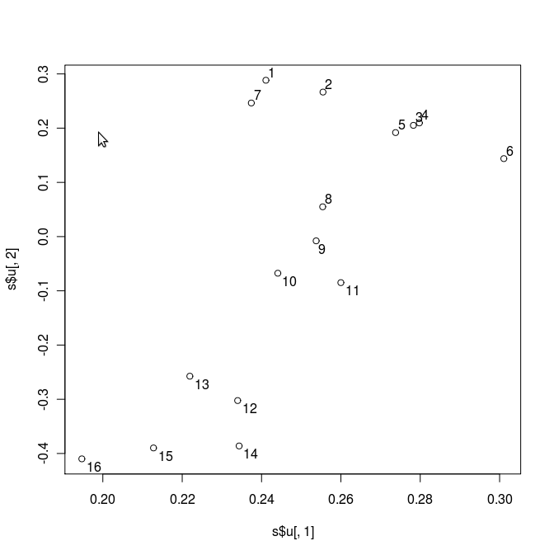
LSA Example
Plot of the first two dimensions of V
1 2 3 4 5 6 7 8 9 10 11 12 13 14 15 16 | b b b b m m m m m m l l l l l l b b b b b m m m m m m m l l l l b b b b b b b m m m m m l l l l b b b b b b b m m m m m m l l l b b b b b b b m m l l l l l l l b b b b b b b b b m m m l l l l r b b b b m m m m m m m l l l l r s s b b b b b b m m m m l l l r s s s b b b b b b m m m m l l r r s s s b b b b b b m l l l l r r s s s b b b b b b b m m m l r r r s s s s s s b b b b b b m r r r r r r s s s b b b b b b l r r s s s s s s s s b b b b b b r r r r s s s s s s s b b b b b r r r r r s s s s s s s b b b b
With:
b: bank
m: money
l: loan
r: river
s: stream
18/06/19
Language Technology Group – Chris Biemann
Notes:
test

Slide 28
Summary on LSA
Advantages:
Exact mathematical computation – however, expensive for large collections
Comparison between documents/words is possible
Reduction to n dimensions („semantic categories“)
Disadvantages:
There is no statistical theory why this works
Unclear how many dimensions are good a priori
Each word can have only one representation: polysemy not modeled
„semantic categories“ is an overstatement
18/06/19
Language Technology Group – Chris Biemann

Slide 29
Distributional Hypothesis Harris, 1954
The Distributional Hypothesis in linguistics is the theory that words that occur in similar contexts tend to have similar meanings.
The Distributional Hypothesis is the basis for Statistical Semantics. It states that the meaning of a word can be defined in terms of its context.
Distributional Hypothesis:
words are characterized by their (typical) contexts: meaning of a word can be defined in terms of its context
words are more similar, the more contexts they share
Any process that builds a structure on sentences can be used as a source for contexts
18/06/19
Language Technology Group – Chris Biemann

Slide 30
Generative Models
…are models for generating observable data randomly, mainly using some hidden parameters
Example: Throw a fair die and observe the output
Output:
2 6 2 3 4 4 3 3 1 6
3 4 6 3 2 1 3 2 5 2
3 3 1 5 5 3 5 3 2 4
Other generative models:
Hidden Markov Chain (HMM)
LDA (Latent Dirichlet Allocation)
18/06/19
Language Technology Group – Chris Biemann

Slide 31
Graphical notation for random variables
Algebraic
Graphical
P(x)
P(x|y)
P(x₁,x₂|y)
P(x|y₁,y₂)
x
x
y
y
x₁
x₂
y₁
y₂
x
Examples from “Graphical Representation – Graphical Models - Gibbs Sampling” by Han Xiao, Ping Luo
18/06/19
Language Technology Group – Chris Biemann

Slide 32
Joint Distribution
x₁
x₂
x₃
x₄
x₆
x₅
18/06/19
Language Technology Group – Chris Biemann

Slide 33
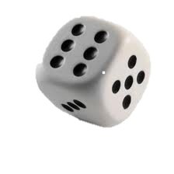
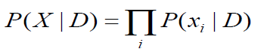
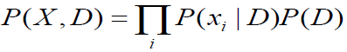
Example: Dice Model
D defines the probability for rolling 1,2,3,4,5,6 and is a hidden (latent) distribution
x_{i} is the number we rolled
generation process:
Sample a number by throwing the die
a multinomial distribution D
N defines how often we roll the die
latent
observed
D
N
observed
x₁
equivalent
x_{N}
D
x_{i}
….
x₂
observed
x₃
observed
Examples adapted from „Generative Probabilistic Models“ from Thijs Westerveld, Arjen de Vries and Franciska de Jong
18/06/19
Language Technology Group – Chris Biemann

Slide 34

Dice Model with two dice
Next assume: We have two dice: Die A is a standard die faced with A=(1,2,3,4,5,6) and die B has faces B=(1,1,1,1,1,1). We want to sample with repeated choice of the dice
Generation Story:
Pick a dice randomly
Sample a number by throwing the die
α
N
D_{A}
D_{B}
α
D
x_{i}
x₀
x₁
…
x_{n}
x_{o}
x₁
…
x_{n}
For completeness we also need a prior probability to choose a die

Slide 35
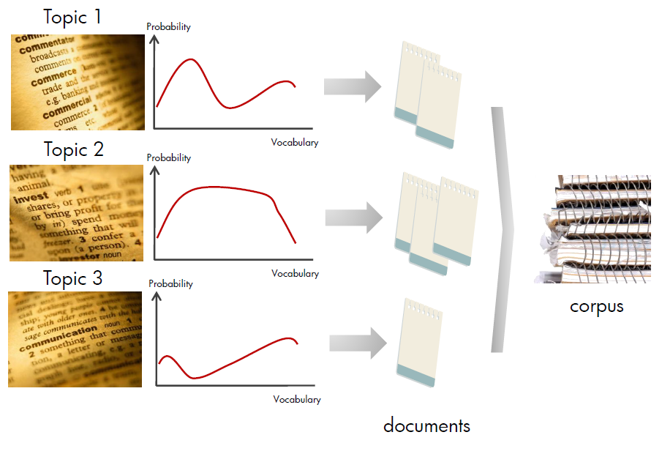
Unigram Model
Generative Story
Pick a language model Z for each document
Draw N w_{i} from multinomial Z
N
Z
w_{i}
Slide borrowed from Han Xiao, Ping Luo
18/06/19
Language Technology Group – Chris Biemann
Notes:
Imagine we have several language models, one for each “topic”
What might be a problem with a unigram model? → Stop Words occur to often

Slide 36
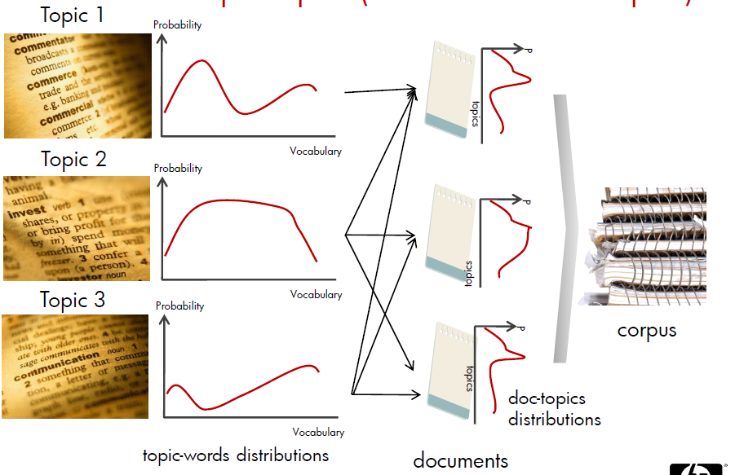
Latent Dirichlet Allocation (Blei et al. 2003)
A document consists of a distribution of topics
Slide borrowed from Han Xiao, Ping Luo
18/06/19
Language Technology Group – Chris Biemann

Slide 37
Latent Dirichlet Allocation (Blei et al. 2003)
In LDA, the topic mixture proportions for each document are drawn from some distribution
So we need a multinomial distribution (k-tuples of non-negative numbers that sum up to one)
Geometrically, the space of these multinomials can be interpreted as a (k-1) simplex, which is a generalization of a triangle to (k-1) dimensions
For the multinomial, a Dirichlet distribution is used as prior (which makes this approach computable and acts like a smoothing parameter)
18/06/19
Language Technology Group – Chris Biemann
Notes:
The space is of all of these multinomials has a nice geometric interpretation as a (k-1)-simplex, which is just a generalization of a triangle to (k-1) dimensions.
Criteria for selecting our prior:
It needs to be defined for a (k-1)-simplex.
Algebraically speaking, we would like it to play nice with the multinomial distribution.

Slide 38
Latent Dirichlet Allocation (Blei et al. 2003)
Generative Story
For each document d in the corpus D
Draw a multinomial distribution Ө (topic distribution used for the document)
Draw each word in document d
Draw a topic Z from multinomial Ө
Draw w from the multinomial Ф
D
N
β
Ө
Z
w
Each document is generated based on a topic distribution
α
α and β are priors, needed to parameterize the distribution
T
Ф
β
K_{t}
α

Slide 39
Latent Dirichlet Allocation (Blei et al. 2003)
Per-word-topic assignment
per-document topic propertions
observed word
D
N
α
Z
w
α
M_{d}
Ө
Proportions parameter
T
Ф
β_{t}
η
K_{t}
α
β
Word Topic Distribution
Word Topic Prior Distribution

Slide 40
Latent Dirichlet Allocation (LDA)
Example topics generated with LDA using a Wikipedia corpus
Topic 7th:
Corp. 0.02833210
technology 0.02470010
computer 0.02451910
market 0.01888910
computers 0.01798110
Computer 0.01489410
Inc. 0.01434910
products 0.01380410
Compaq 0.01162510
chips 0.01126110
company 0.01053510
machines 0.01035310
Technology 0.00962710
Sun 0.00944510
sales 0.00908210
personal 0.00908210
next 0.00853710
electronic 0.00835610
Intel 0.00835610
Topic 11th:
dollar 0.05227010
U.S. 0.03612410
currency 0.02312510
was 0.02203110
yen 0.02148310
marks 0.01806310
rates 0.01765210
late 0.01628410
trade 0.01587310
Lawson 0.01382110
Thatcher 0.01231610
interest 0.01204210
exchange 0.01190510
rate 0.01149510
economic 0.01122110
pound 0.01081110
Bank 0.00985310
Britain 0.00957910
British 0.00916910
Topic 92th:
years 0.02375010
may 0.02233410
cost 0.02154810
provide 0.02139110
service 0.02139110
result 0.01808810
services 0.01635810
additional 0.01588610
based 0.01384110
period 0.01305510
number 0.01305510
most 0.01195410
terms 0.01164010
information 0.01116810
time 0.01069610
provided 0.01053910
future 0.01038210
figure 0.01038210
financial 0.01022410
18/06/19
Language Technology Group – Chris Biemann

Slide 41
Learning the LDA Model
The exact calculation is intractable
Approximation algorithms:
Mean field variational inference
Expectation propagation
Collapsed Gibbs Sampling
Collapsed Variational Inference
18/06/19
Language Technology Group – Chris Biemann

Slide 42
Collapsed Gibbs Sampling
Gibbs Sampling can be used to maximize P(x) = P(x₁, …,x_{D})
P(x) does not need to be known, but it must be possible to draw samples from the full conditional probability function P(x_{d}|x_{-d}) for all 1≤d≤D
Algorithm:
Randomly initialize X⁽⁰⁾= {x₁⁽⁰⁾, …,x_{D}⁽⁰⁾}
For t=1…T (T is the number of iterations)
For d=1…D (e.g. all words of a document)
Sample X ~ P(x_{d}|x_{1,..,d-1}^{(t)},..,x_{d+1,..,D}^{(t-1)}) (Assign X a value according to the probability of all other assigned values)
Use n last assignments to calculate the probabilities
18/06/19
Language Technology Group – Chris Biemann

Slide 43
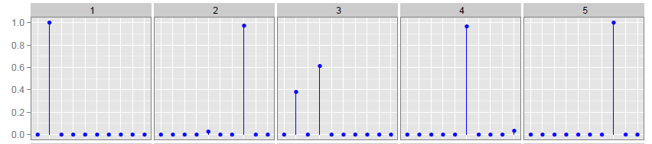
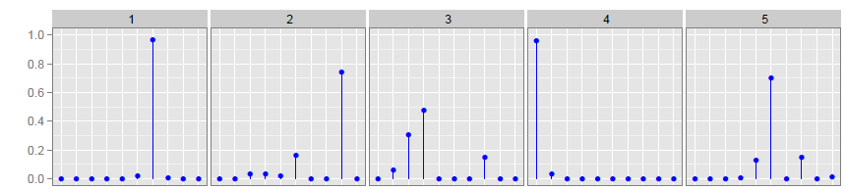
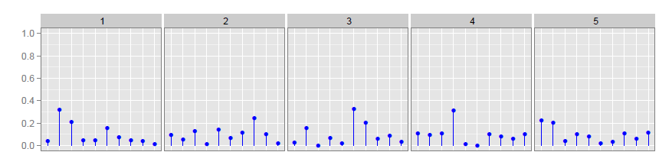
Priors Distribution Parameters α and β
α: regulates the sparseness of the topic-per-document distribution. Lower values result in documents being represented by fewer topics
β: regulates the sparsity of topics, by assigning fewer terms to each topic, which is correlated to how related words need to be for being assigned to a topic
Topic Distribution for documents
Word Distribution for Topics
Topic1
Topic 2
Topic 3
Topic 4
Topic 5
Doc. 1
Doc. 2
Doc. 3
Doc. 4
Doc. 5
α = 0.01
Words
β =0.0001
Topics
α = 0.1
β =0.01
β =10.0
α = 1.0
Graphics adapted from Blei, 2011
18/06/19
Language Technology Group – Chris Biemann

Slide 44
Example of training a LDA Model
Example: We want to train 2 topics with α=1 and β=0.1
Doc 1 | a | a | b | b | a | a
Doc 2 | a | b | b | c | c | a
Doc 3 | d | d | d | c | c
Doc 4 | d | c
18/06/19
Language Technology Group – Chris Biemann

Slide 45
Example of training a LDA Model
Example: We want to train 2 topics with α=1 and β=0.1
Initialize topics randomly
Doc 1 | a | a | b | b | a | a
 | 2 | 2 | 1 | 1 | 2 | 1
Doc 2 | a | b | b | c | c | a
 | 2 | 1 | 1 | 1 | 2 | 2
Doc 3 | d | d | a | c | c
 | 1 | 2 | 1 | 2 | 1
Doc 4 | d | c
 | 1 | 1
18/06/19
Language Technology Group – Chris Biemann

Slide 46
Example of training a LDA Model
Example: We want to train 2 topics with α=1 and β=0.1
Sample new topic for first word in first document →Delete topic of actual word
# topic 1 (z1) with “a” divided by #topic 1
Doc 1 | a | a | b | b | a | a
 | ??? | 2 | 1 | 1 | 2 | 1
Doc 2 | a | b | b | c | c | a
 | 2 | 1 | 1 | 1 | 2 | 2
Doc 3 | d | d | a | c | c
 | 1 | 2 | 1 | 2 | 1
Doc 4 | d | c
 | 1 | 1
# topic 1 (z1) in doc 1 divided by topics in Doc 1
18/06/19
Language Technology Group – Chris Biemann

Slide 47
Example of training a LDA Model
Example: We want to train 2 topics with α=1 and β=0.1
Sample new topic for first word in first document
# topic 1 (z1) with “a” divided by #topic 1
Doc 1 | a | a | b | b | a | a
 | ??? | 2 | 1 | 1 | 2 | 1
Doc 2 | a | b | b | c | c | a
 | 2 | 1 | 1 | 1 | 2 | 2
Doc 3 | d | d | a | c | c
 | 1 | 2 | 1 | 2 | 1
Doc 4 | d | c
 | 1 | 1
# topic 1 (z1) in doc 1 divided by topics in Doc 1
18/06/19
Language Technology Group – Chris Biemann

Slide 48
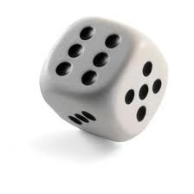
Example of training a LDA Model
Example: We want to train 2 topics with α=1 and β=0.1
Sample new topic for first word in first document
Doc 1 | a | a | b | b | a | a
 | ??? | 2 | 1 | 1 | 2 | 1
Doc 2 | a | b | b | c | c | a
 | 2 | 1 | 1 | 1 | 2 | 2
Doc 3 | d | d | a | c | c
 | 1 | 2 | 1 | 2 | 1
Doc 4 | d | c
 | 1 | 1
Randomly Sample a number [0;0.34]:
0-0.11: Topic 1
Else: Topic 2
0.3 → Topic 2
2
18/06/19
Language Technology Group – Chris Biemann

Slide 49
Example of training a LDA Model
Example: We want to train 2 topics with α=1 and β=0.1
Sample next topic for each word in each document and repeat the process N times (until no substantial changes)
Doc 1 | a | a | b | b | a | a
 | 2 | ??? | 1 | 1 | 2 | 1
Doc 2 | a | b | b | c | c | a
 | 2 | 1 | 1 | 1 | 2 | 2
Doc 3 | d | d | a | c | c
 | 1 | 2 | 1 | 2 | 1
Doc 4 | d | c
 | 1 | 1
18/06/19
Language Technology Group – Chris Biemann

Slide 50
Example of training a LDA Model
Example: We want to train 2 topics with α=1 and β=0.1
After 1000 iterations
Doc 1 | a | a | b | b | a | a
 | 1 | 1 | 1 | 1 | 1 | 1
Doc 2 | a | b | b | c | c | a
 | 1 | 1 | 1 | 2 | 2 | 1
Doc 3 | d | d | a | c | c
 | 2 | 2 | 2 | 2 | 2
Doc 4 | d | c
 | 2 | 2
18/06/19
Language Technology Group – Chris Biemann

Slide 51
Example of training a LDA Model
Example: We want to train 2 topics with α=1 and β=0.1
Now we can calculate the word topic distribution
1) Count #topic/term
2) Use Smoothing factor β for zero counts
Doc 1 | a | a | b | b | a | a
 | 1 | 1 | 1 | 1 | 1 | 1
Doc 2 | a | b | b | c | c | a
 | 1 | 1 | 1 | 2 | 2 | 1
Doc 3 | d | d | a | c | c
 | 2 | 2 | 2 | 2 | 2
Doc 4 | d | c
 | 2 | 2
 | Topic 1 | Topic 2
a
b
c
d
6 | 1
4 | 0.1
0.1 | 5
0.1 | 3
6/10.2 | 1/9.1
4/10.2 | 0.1/9.1
0.1/10.2 | 5/9.1
0.1/10.2 | 3/9.1
0.59 | 0.11
0.39 | 0.01
0.01 | 0.55
0.01 | 0.33
6 | 1
4 | 0
0 | 5
0 | 3
3) Normalize per topic
18/06/19
Language Technology Group – Chris Biemann

Slide 52
Example of training a LDA Model
Example: We want to train 2 topics with α=1 and β=0.1
We can also calculate the document topic distribution
1) Count #topic/document
2) Add smoothing for zero
values (α)
Doc 1 | a | a | b | b | a | a
 | 1 | 1 | 1 | 1 | 1 | 1
Doc 2 | a | b | b | c | c | a
 | 1 | 1 | 1 | 2 | 2 | 1
Doc 3 | d | d | a | c | c
 | 2 | 2 | 2 | 2 | 2
Doc 4 | d | c
 | 2 | 2
3) Normalize per document
 | Topic 1 | Topic 2
Doc 1 | 7 | 0
Doc 2 | 4 | 2
Doc 3 | 0 | 5
Doc 4 | 0 | 2
7 | 1
4 | 2
1 | 5
1 | 2
6/7 | 1/7
4/6 | 2/6
1/6 | 5/6
1/3 | 2/3
0.85 | 0.15
0.67 | 0.33
0.17 | 0.83
0.33 | 0.76
18/06/19
Language Technology Group – Chris Biemann

Slide 53
Example of training a LDA Model
Output of LDA
A word topic distribution
A topic word distribution
A document topic distribution
A document where each word is assigned to a topic (see previous slide)
Topic 1
Topic 2
“a” “b” “c” “d”
Topic1 | Topic2
a:80% | d:75%
b:65% | c:60%
c:40% | b:35%
d:25% | a:20%
Doc1 Doc2 Doc3 Doc4
18/06/19
Language Technology Group – Chris Biemann

Slide 54
Applications using LDA
Text clustering
Characterize content of a collection, popular in social sciences and the Digital Humanities
Find similar texts a user is interested in, e.g. news recommendation system
Illustrate changing topic distribution over time
Text Segmentation in topical segments
18/06/19
Language Technology Group – Chris Biemann

Slide 55
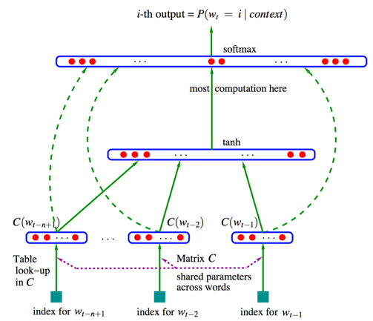
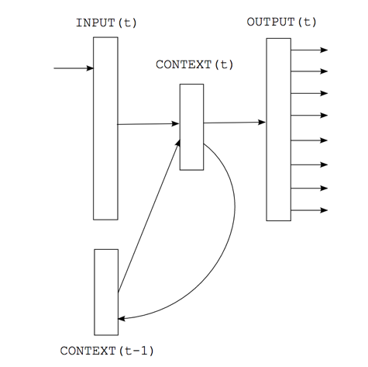
Neural Word Embeddings
Recap: Neural Language Models
Need continuous representations of words
These are trained in order to predict the next word, given previous words

Slide 56
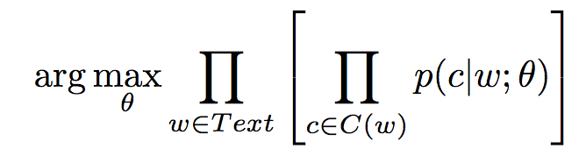
Neural Version of Distributional Hypothesis
A word can be predicted by its context
OR: its context can be predicted by a word
words and contexts are represented by dense vectors
that are trained as to maximize the probability of a corpus
assuming that this happens when similar words get similar dense vector embeddings
18/06/19
Language Technology Group – Chris Biemann

Slide 57



Some popular pre-trained dense word embeddings
word2vec (Mikolov et al., 2013)
https://code.google.com/archive/p/word2vec/
fastText (Bojanowski et. al., 2017)
http://www.fasttext.cc
GloVe (Pennington et al., 2014)
http://nlp.stanford.edu/projects/glove
18/06/19
Language Technology Group – Chris Biemann

Slide 58
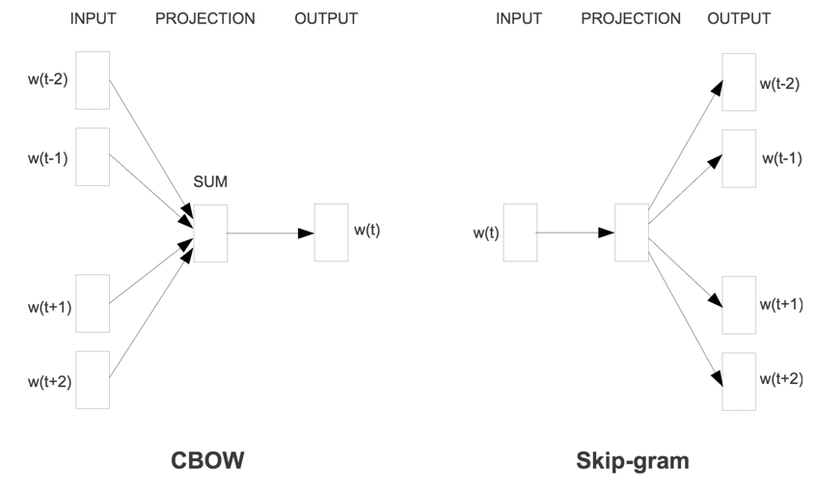
Word2Vec https://code.google.com/archive/p/word2vec/
Two architectures; both work:
CBOW: predict word, given its close context. Bag-of-words within context
SKIP-gram: predict context, given a word. Takes order into account.
Mikolov, T., Chen, K., Conrado, G., Dean, J. (2013) Efficient Estimation of Word Representations in Vector Space. Proceedings of the Workshop at ICLR, Scottsdale, pp. 1-12.
18/06/19
Language Technology Group – Chris Biemann

Slide 59
Word2Vec: Skip-Gram Task
word2vec provides a variety of options. Here in more detail: "skip-gram with negative sampling" (SGNS)
Skip-gram algorithm:
Treat the target word and a neighboring context word as positive examples.
Randomly sample other words in the lexicon to get negative samples
Use logistic regression to train a classifier to distinguish those two cases
Use the weights as the embeddings
18/06/19
Language Technology Group – Chris Biemann

Slide 60
Skip-Gram Training Data
Training sentence: Assume context words are those in +/- 2 word window.
... lemon, a tablespoon of apricot jam a pinch ...
c1 c2 target c3 c4
Given a tuple (t,c) = target, context
(apricot , jam)
(apricot, aadvark)
Return probability that c is a real context word:
P(+|t,c)
P(−|t,c) = 1−P(+|t,c)
18/06/19
Language Technology Group – Chris Biemann

Slide 61
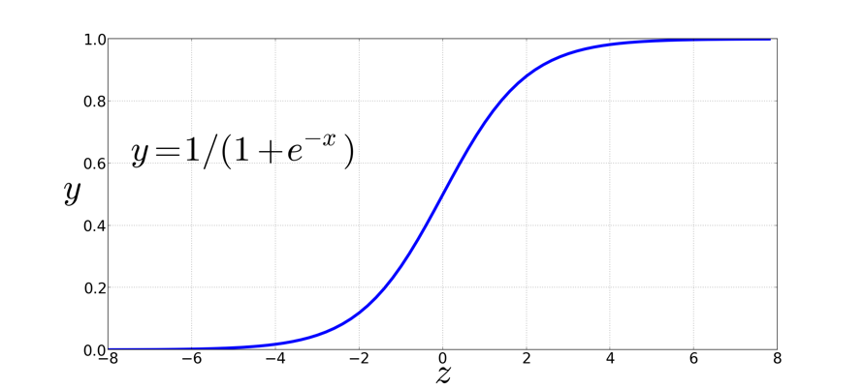
How to compute p(+|t,c)?
Intuition:
Words are likely to appear near similar words
Model similarity with dot-product
Similarity(t,c) ∝ t ∙ c
Turning dot product into a probability
18/06/19
Language Technology Group – Chris Biemann

Slide 62
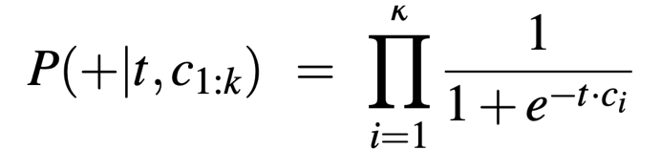
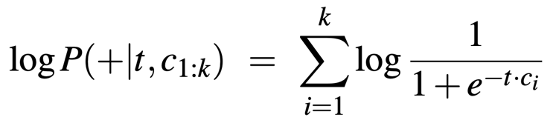
Computing probabilities
Turning dot product into a probability:
Assume all context words are independent:
18/06/19
Language Technology Group – Chris Biemann

Slide 63
Skip-gram training
Training sentence: Assume context words are those in +/- 2 word window.
... lemon, a tablespoon of apricot jam a pinch ...
c1 c2 target c3 c4
18/06/19
Language Technology Group – Chris Biemann

Slide 64
Negative Sampling: Choosing noise words
Need to prevent that all words get the same vector.
For each observed word-context pair, also ‘observe’ random contexts
change objective function to assign a low probability to random contexts and high probability to real observations
Could pick w according to their unigram frequency P(w)
More common to chosen then according to p_{α}(w)
α= 0.75 works well because it gives rare noise words slightly higher probability
18/06/19
Language Technology Group – Chris Biemann

Slide 65
Objective function
We want to maximize…
Maximize the + label for the pairs from the positive training data, and the – label for the negative samples.
18/06/19
Language Technology Group – Chris Biemann

Slide 66
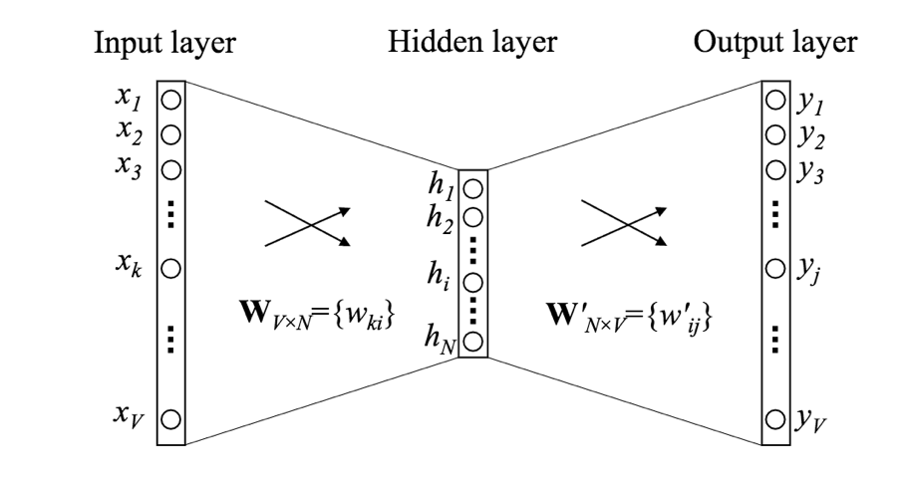
Embeddings: weights to/from projection layer
W_{in}
W_{out}
Example: simple continuous BOW bigram model
W_{in} and W_{out}^{T}: V x N matrices
every word is embedded in N dimensions, which is the size of the hidden layer
Note: embeddings for words and contexts differ
18/06/19
Language Technology Group – Chris Biemann

Slide 67
VaRiants of Word2Vec
subsampling of frequent words (not informative contexts)
rare-word pruning
dynamic window size
hierarchical softmax (speedup)
18/06/19
Language Technology Group – Chris Biemann

Slide 69
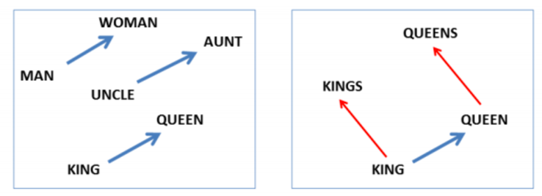
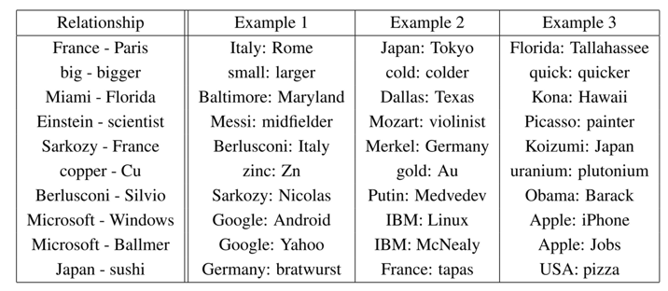
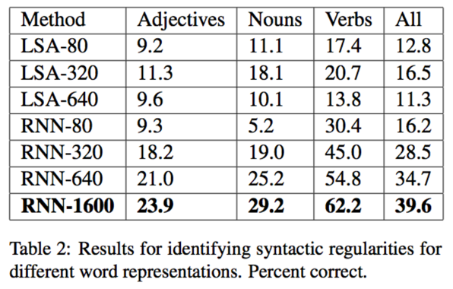
Vector Algebra for Analogy Questions
Observation: words in the same relation have similar vector differences
Syntactic analogy questions: “a is to b as c is to ...” (rough is to rougher as tough is to ...)
This is a wildly overestimated feature: the same semantic relation has DIFFERENT directions in subspaces
Mikolov, T., Yih, W., Zweig, G. (2013): Linguistic Regularities in Continuous Space Word Representations. Proc. HLT-NAACL '13, pp. 746-751
18/06/19
Language Technology Group – Chris Biemann

Slide 70
Count or Predict?
Much previous debate why prediction-based models seem to perform better than count-based models
In reality, they are the same, as shown by Levy & Goldberg (2014):
Skip-gram negative sampling performs implicit matrix factorization with PMI weighting
This is equivalent to an approximation of SVD, shifted by a global constant
Advances on tasks largely attributed to more parameter tuning
”If you want to get good results, you should tune your hyperparameters. And if you want to make good science, don’t forget to tune your baselines’ hyperparameters too!” - Omer Levy, pers. communication
Levy, O. and Goldberg, Y. (2014): Neural word embedding as implicit matrix factorization. Advances in neural information processing systems, pp. 2177-2185
18/06/19
Language Technology Group – Chris Biemann

Slide 71
CurrEnt Directions
Better address OOV problems: use character-n-gram-based models, e.g. fasttext https://github.com/facebookresearch/fastText
Use grammatical context, e.g. word2vecf https://bitbucket.org/yoavgo/word2vecf
Train your specialized embeddings vs. learn a projection on ‘default’ embeddings, e.g. http://ahogrammer.com/2017/01/20/the-list-of-pretrained-word-embeddings/
From word embeddings to sense embeddings
Contextualized embeddings, e.g. BERT, GTP, ELMo, e.g. https://github.com/google-research/bert
There is a large variety of models that learn embeddings.
18/06/19
Language Technology Group – Chris Biemann

Slide 72
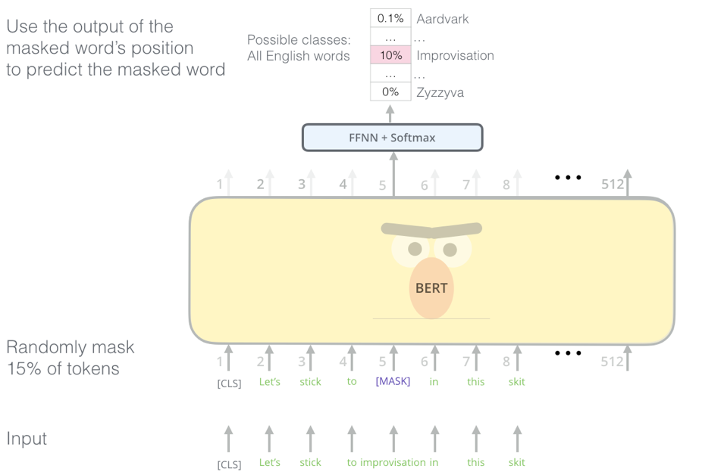
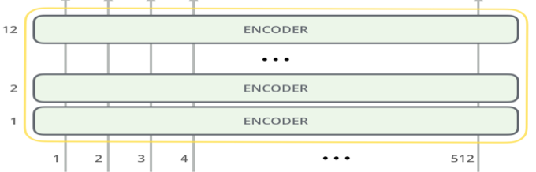
Illustrating contextualized BERT EMBEDDINGS
Training: Masked word prediction (a form of language modelling)
Use: all or just some of the 12/24 transformer layers per token
http://jalammar.github.io/illustrated-bert/
18/06/19
Language Technology Group – Chris Biemann

Slide 73
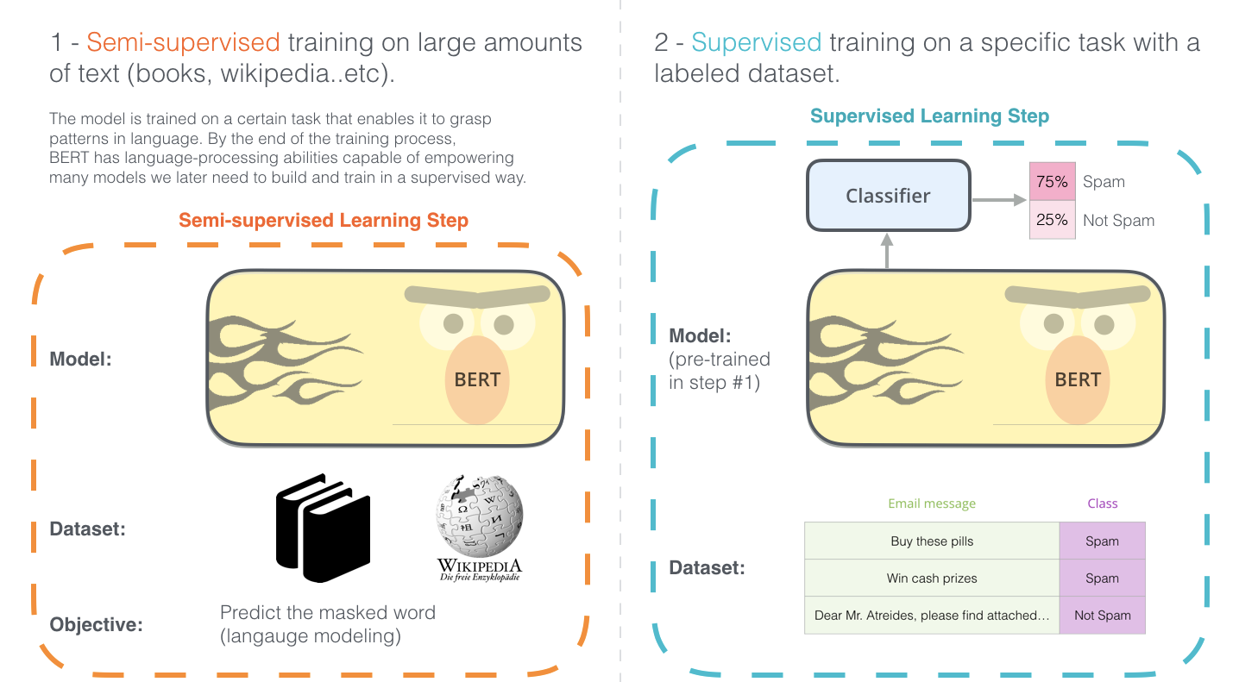
Using CLMs in tasks
c
http://jalammar.github.io/illustrated-bert/

Slide 74
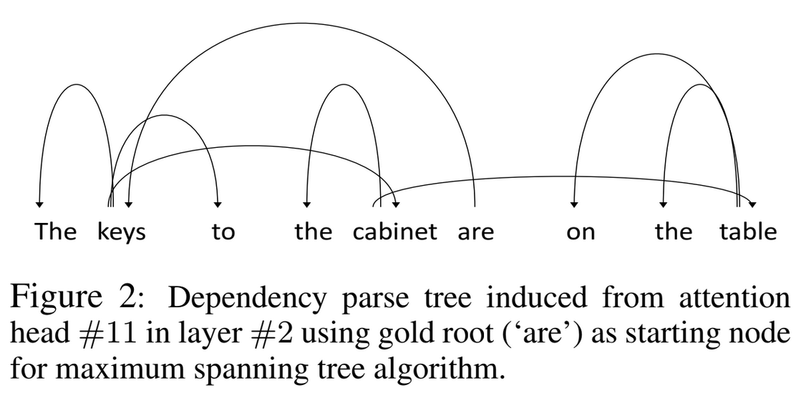
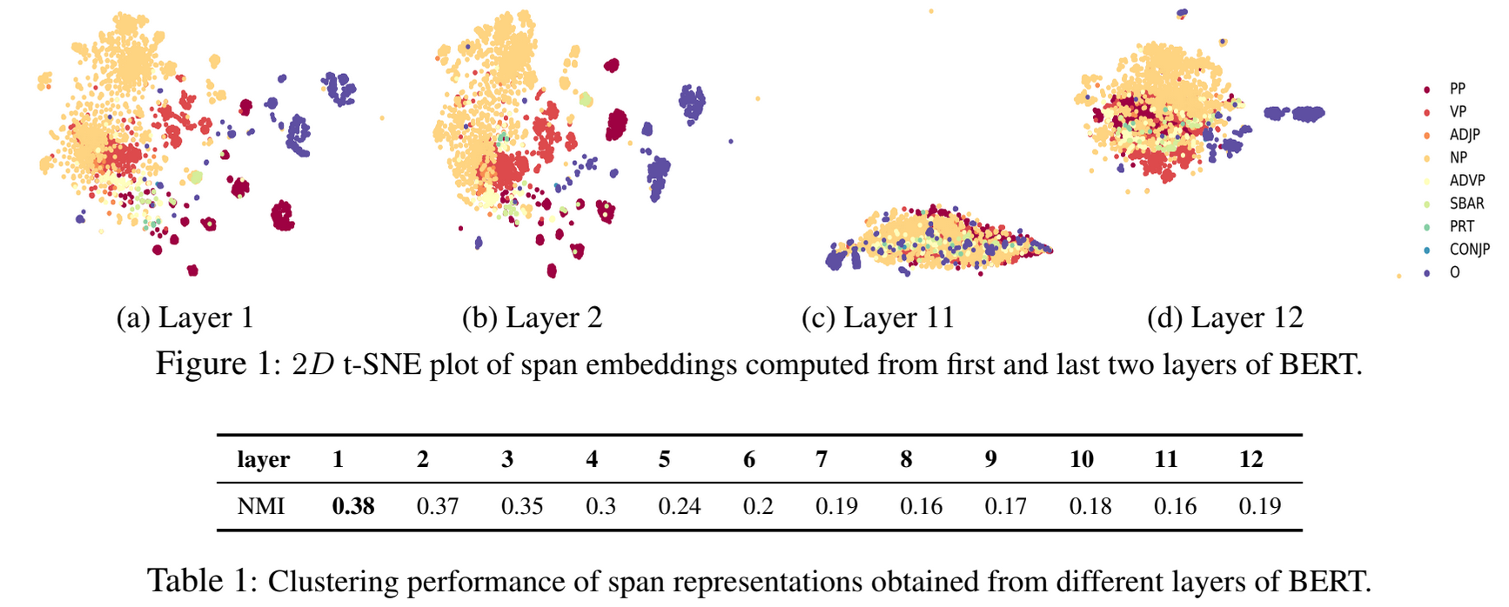
Some BERT insights
different layers seem to model different linguistic structures. here: grammar:
Ganesh Jawahar, Benoît Sagot, Djamé Seddah. What does BERT learn about the structure of language?. ACL 2019 - 57th Annual Meeting of the Association for Computational Linguistics, Jul 2019, Florence, Italy

Slide 75
Summary on Dense Vector Representations
Core idea: make documents or words comparable by real-valued representations
Similar items should receive similar representations, which serves as a layer of abstraction
Representations can be mathematically computed (LSA), sampled (LDA) or learned (word2vec)
Dense vectors required as input layer for neural methods, but also suitable as features in any ML-based NLP architecture
Principles have been known in the NLP community for over 25 years
neural embeddings gained a lot of attention is due to more efficient approximate implementations
recent advances on contextualized embeddings make a huge difference
18/06/19
Language Technology Group – Chris Biemann

Slide 76


Immediate Feedback
s

Slide 77
Graph-based methods for NLP
Brin, S. and Page, L. (1998). The anatomy of a large-scale hypertextual web search engine. Computer Networks and ISDN Systems, 30(1-7), 107–117.
Erkan, G. and Radev, D. R. (2004). Lexrank: Graph-based lexical centrality as salience in text summarization. Journal of Artiﬁcial Intelligence Research (JAIR), 22, 457–479.
Mihalcea, R. and Tarau, P. (2004). Textrank: Bringing order into texts. In Proceedings of the conference on Empirical Methods in Natural Language Processing (EMNLP-04), pages 404–411, Barcelona, Spain.
Mihalcea, R. and Radev, D. (2011). Graph-based Natural Language Processing and Information Retrieval. Cambridge University Press
coming up next
graphs, networks, PageRank, graph clustering
18/06/19
Language Technology Group – Chris Biemann

